Slide 1

Flextrade
User Experience Analysis for FlexTrade online Shopping App

Slide 2

Business Overview
FlexTrade is a well-known company in the online shopping world. They have been making shopping easier and better for a long time. They sell all kinds of things, from electronics to clothes.Their app is designed to be easy to use, hoping to make shopping fun and simple for everyone.

Slide 3
Description
FlexTrade wants to keep improving their app to make sure they stay ahead in the competitive online shopping market. This project will look into how they can make their app even better for users.
In this case study we will be looking at 3 datasets namely:
App Analytics Data: This data contains 7 headers: User_ID, Session_ID, Timestamp, Page_views, Bounce_Rate, Add_to_Cart_Rate and Conversion_Rate
User Behaviour Data: This data contains the following headers:User_ID, Session_ID, Timestamp, Session_Duration, Product_views, Cart_Additions, Checkout_Progress.
User Feedback Data: This data contains the following data headers: User_ID, Feedback_ID, Timestamp, Feedback_Type, Feedback_Content.

Slide 4
Description
Even though lots of people download and use the FlexTrade app, not everyone ends up buying
something. There are a few problems:
High Bounce Rate: Many users leave the app quickly without buying anything.
Cart Abandonment: Users put items in their cart but don't complete the purchase.
Low Average Order Value: The amount of money users spend is lower than what FlexTrade
would like.
Lots of Competition: There are many other shopping apps out there, so FlexTrade needs to
stand out.

Slide 5
Aim of this Analysis
The Aim of this analysis is to:
Find UX Problems: Look at how users behave and what they say to find out what needs to
be better.
● Make Checkout Better: Make it easier and quicker for users to buy things.
● Suggest Personalized Products: Use what we know about what users like to suggest other
things they might buy.
● Get Users to Buy More: Figure out ways to encourage users to spend more money.

Slide 6
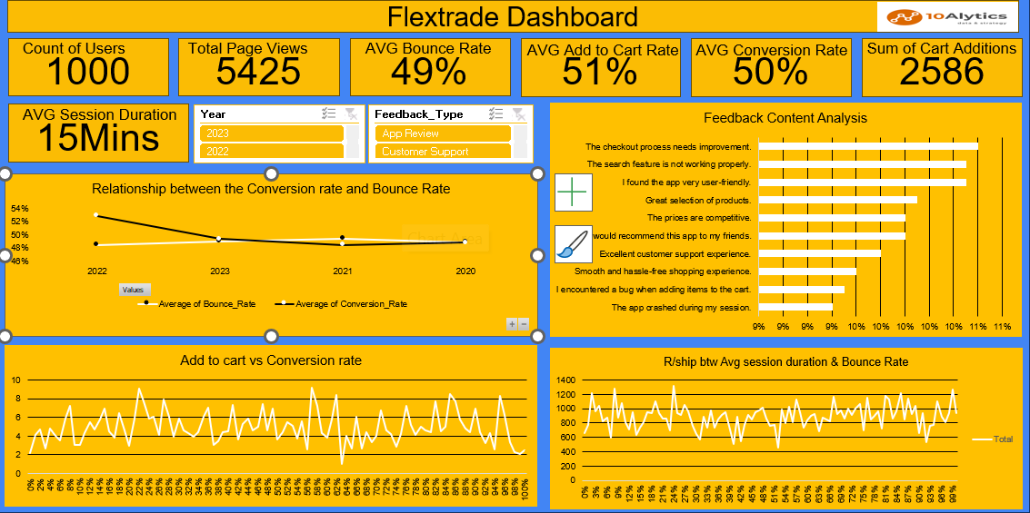

Slide 7
Relationship between Average Session Duration and Bounce Rate
The bounce rate does not increase but it does flunctuate averagely between 600 and 1300.
The bounce rate does not affect the average session, but there is a relationship between the bounce rate and the average session duration.

Slide 8
Relationship between the Conversion Rate and the bounce rate
There is a relationship between the Bounce rate and the conversion rate, as we can see in the chart when the bounce rate increases the conversion rate increases except in the third Quarter of every year, where the bounce rate increases and the conversion rate decreases and vice versa.
Apart from this change there is a trend between the bounce rate and the conversion rate.

Slide 9
Add to cart vs Conversion rate
The add to cart and conversion trend is unstable.

Slide 10
Feedback Content Analysis
With the feedback content received shows;
That customers are finding it difficult to navigate the checkout process.
The search feature needs to be reviewed.
Some customers also get bugs when adding items to cart.
The app also crash on some user’s device

Slide 11
Recommendations
Looking at the feedback gotten from users of this app I recommend that;
The checkout page should be reviewed along side the search button, as this could be the reason why the average session duration and the Bounce rate is not stable
Also the add to cart button showed be reviewed as this could be the reason why the add to cart and the conversion rate is also not stable as some users get bugs when adding products to their cart.
Reasons why app crash on user devices should be investigated, this may be the users screen resolution or the operating system.

